Slide 1
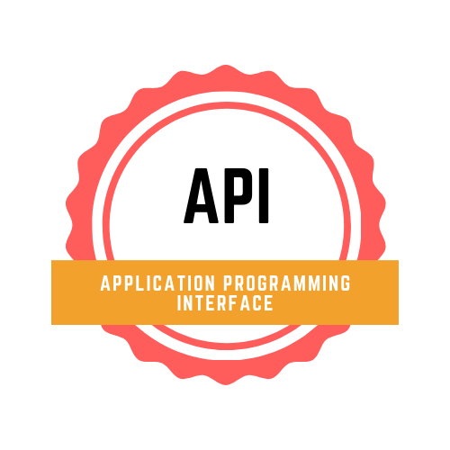
MEAL MAGIC
Based on Spoonacular API

Slide 2
Tribe E
Adarsh Dash
Hanesh Sunil Jogani
Sakshi Zalavadia
Aniket Ojha
Priyansh Jinwala
Shweta Singh
Arfa Aslam Bargir
Qiyamuddin Ghaws Khan
Sombir
Balaji.G
Ramzan Ali
Ziyaulhaq Khan

Slide 3
Brief Introduction

Slide 4
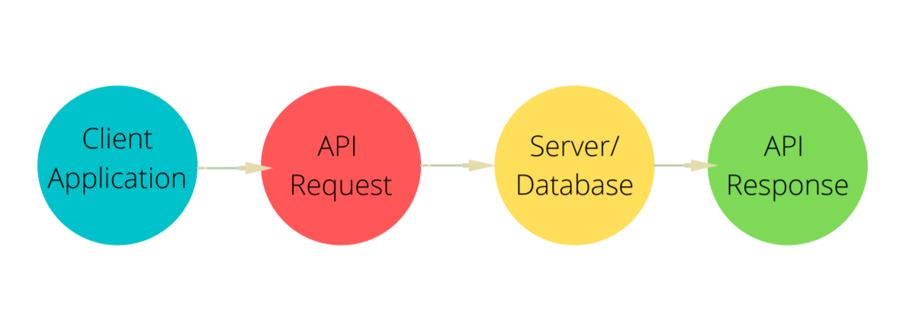

Slide 5
Needs/Interview Overview
1
StakeHolder’s Panel-
GYM Trainer
Dietician
Foodie

Slide 6
Needs/Interviews
Having a word with the stakeholders few of the major points which came to light were
Need for a forum/application where a cumulative details of recipes and ingredients can be displayed.
There are instances where a person speaks about their favourite dishes and/or,one has no idea about the taste the person has.
FitnessFreaks hover on the online platforms to search for their diet which is wrong like diet should be to their personal interests.
Having out all the ingredients at the home for a particular dine is not possible always.

Slide 7
Approach
2

Slide 8
Approach
Since we have got our requirements we have our approach towards the same in shape. So here it goes.
A web page including the normal user login and logout system, a search bar for the user's to search for the recipes.
Cumulation of recipes based on different ingredients.
Suggestion for random recipes to the users based on the user's favourite recipes.
Making up of a text reader which predicts out the taste of the person from the text entered.

Slide 9
Project Scope
3

Slide 10
Project Scope
FitnessFreaks who are concerned about the daily intake of proteins, carbs can make down a meal plan and make it suitable according to their needs.
People who are much more into food and are looking out for new variant of cuisines daily, can be benefited from this.
Daily random recipes based on user’s search.
User can give out his details and he/she can get the recipes according to the details given.

Slide 11
Functionality
4

Slide 12
Functionality
Landing into the web page the user will be able to search for the recipe which he/she wishes to search for. After typing in the dish name one needs to select/enter the Search Recipe Button.
This will show the list of recipes relevant to the name entered by the user.
Adding to this if the user wishes to download it over their devices so we have an option of
Downloading in PDF/PNG format
Sharing over platforms including Whatsapp or Twitter
Additionally if the user wishes to get some daily random recipes to be there every time he/she visits the webpage then the user must have an account registered.
Secondly, a form type interface will be there.
For the users who are into fitness, they can enter down the amount of protein/carbs which he/she wishes to intake, entering the same it will display out the recipes relevant to the same.
The user needs to type in the ingredients available with him/her at present. Following which the user will be shown the list of dishes/recipes which can be prepared from the ingredients entered.
Lastly, a textbox input will be shown wherein the user need to enter a text describing out his/her favourite dishes or so. Result will be the text with the highlighted words. The highlighted words will be from the dishes and/or the ingredients from the text entered.

Slide 13
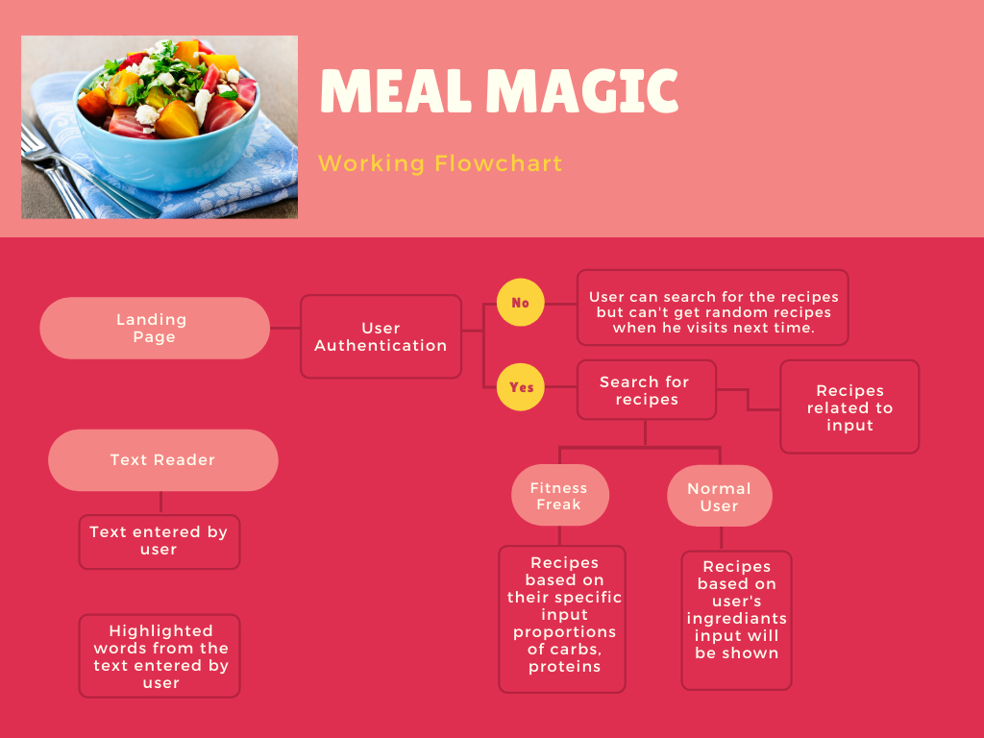

Slide 14
Development
5

Slide 15
Development
Starting with we will create a web application/web page which will be built over HTML, CSS with ReactJS Framework.
Using spoonacular API and creating the API Key.
User makes a account(optional), mandatory if he/she want's recommendations for the recipes.
Storing the searches into a database according to the user's account to analyze the searches to give recommendations for daily recipes.
Input form for taking in the inputs and fetching out the relevant details from the API.
Configuring the api and the development according to the input data.
Deployment

Slide 16
Technology
6

Slide 17
Technology
Basic Languages - HTML, CSS, JS
FrameWork - ReactJS
Backend - NodeJS
Databases - MongoDB
API - spoonacular API

Slide 18
Project Deadline:
 | WEEK 01 26/06/2021 | WEEK 02 03/07/2021 | WEEK 03 10/07/2021 | WEEK 04 17/07/2021 | WEEK 05 24/07/2021 | WEEK 06 31/07/2021
BRD | DONE
Solution Document, Environment Setup
Development, Milestone-1
Development, Milestone-2
Develop, Demo the increment, Test, Milestone - 3
Develop, Final Demo, Test Results, User Acceptance Document

Slide 19
Thanks!
ANY QUESTIONS?

